Slide 1


(deergho-ee)

Slide 2
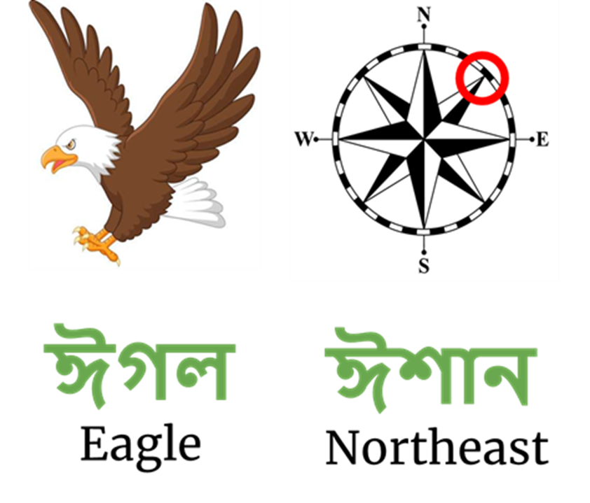
(eegawl)
(eeShan)

